Slide 1
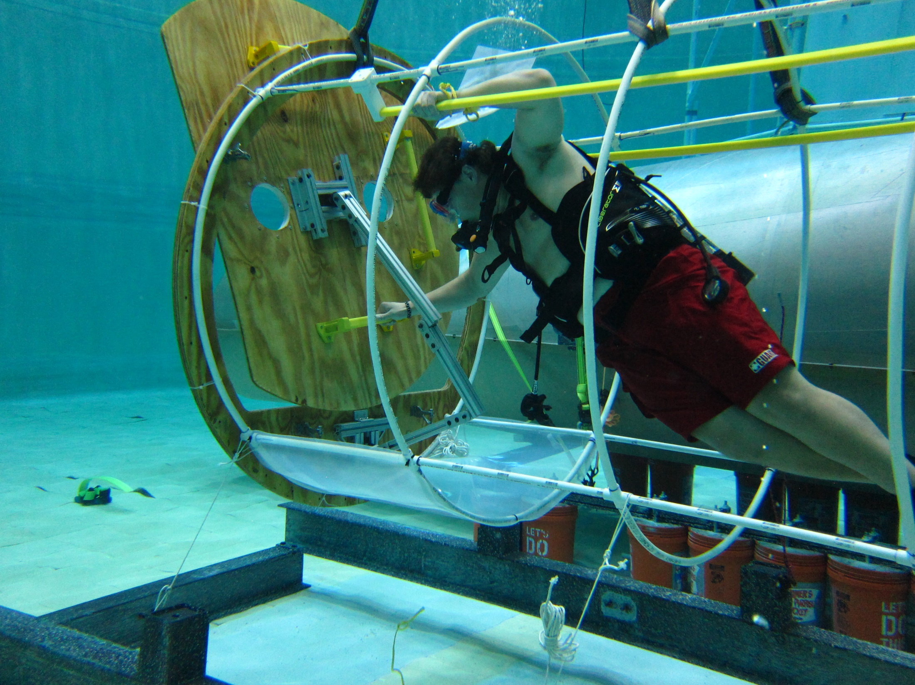
XHAB – Inflatable Airlock
Final Design Review – University of Maryland – July 22, 2016

Slide 2
Team Structure – Fall 2015
Faculty Mentor: Dr. David L. Akin
Fall 2015: ENAE 100 Teams
Scale Envelope team:
Alex Conrad, Emery Bacon, Cemre Sahinci, Amanda Modica
Hatch Design team:
Nolan McMahon, Matt Vaughn, Joshua Joress, Ben Conway
Student Mentors:
Caroline Duffy, Katie Gaverth

Slide 3
Team Structure – Spring 2016
Faculty Mentor: Dr. David L. Akin
Spring 2016: ENAE 484 team:
42 Aerospace Engineering seniors
6 students in “build team”: David Foster, Ben Nichols, Devin Murphy, Matt Gisriel, Ari Videlefsky, and Dylan Henry
Detailed DDT&E component of NASA RASC-AL design competition for Phobos Outpost

Slide 4
Team Structure – Summer 2016
Faculty Mentor: Dr. David L. Akin
Summer 2016: SSL test team
Ben Nichols
Justin Kanga
Jian-Ming Chang
Lem Carpenter
Fabrication and testing of major airlock elements

Slide 5
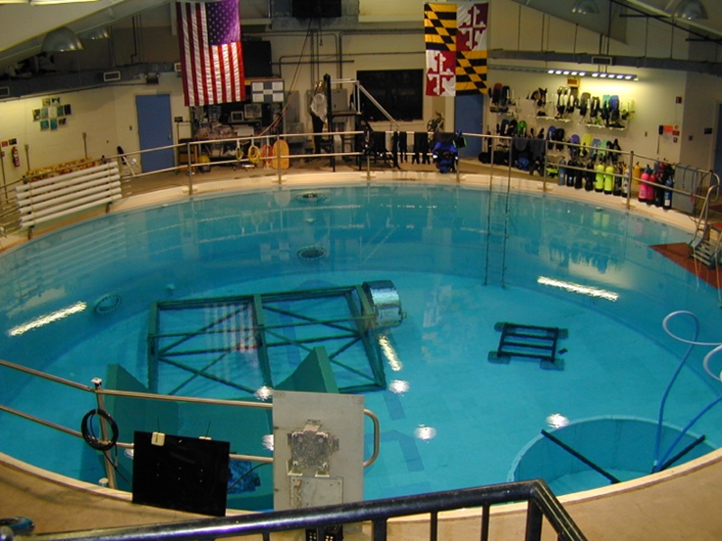
UMD Neutral Buoyancy Research Facility

Slide 6
Program Objectives
Develop the requisite technology for airlock design via analysis and scale-model experimental tests
Design, develop, test, and evaluate a two-person inflatable airlock compatible with an international docking interface
Perform human operations evaluation in microgravity via neutral buoyancy simulation
Maximize opportunities for student involvement at all levels consistent with educational objectives for associated courses

Slide 7
Concept of Operations
Inflatable airlock to be used to transition two pressure-suited crew from cabin atmosphere to space environment and return
Cylindrical airlock configuration optimal to support two crew with minimal excess volume
Ideal transit paths are radial for planetary systems, axial for microgravity
Future mission applications: microgravity servicing, asteroid missions, Mars moons, Moon and Mars surface

Slide 8
Level 1 Requirements
Inflatable airlock shall be designed for two crew in EMU suits
Airlock shall be designed to interface to IDS at lower end
Airlock shall be capable of maintaining shape and supporting crew translation loads while unpressurized (Egress hatch open)
Structure shall be designed for 14.7 psi operating pressure while meeting NASA standard design FOS
Airlock operability shall be assessed in neutral buoyancy simulation

Slide 9
Derived Requirements
Cylindrical section of airlock shall be 1.5 m diameter (60 in) by 2 m long (80 in)
Proximal end of airlock shall attach to standard International Docking System (IDS) module
External hatch of airlock shall be designed to be seated in direction of pressure forces
Hatch mechanism shall be designed to minimize internal volume set-asides for airlock hatch actuation

Slide 10
Airlock Baseline
2.03 m
1.54 m

Slide 11
Structural Analysis of Webbed Restraint Layer
Working pressure 14.7 psi = 101 kPa
Required FOS=4
Hoop stress 303 kN/m
Longitudinal stress 152 kN/m
Available 2in kevlar strapping has tensile strength of 876 kN/m
Minimum web structure requires 35% fill factor → 2in strap produces 2.9 in open grid pattern
Requires further analysis/test to determine maximum allowable gap based on characteristics of inner cloth restraint layer
Webbed restraint structure is feasible

Slide 12
FEM Analysis of Airlock Bulkhead
Used NX to model flat cylindrical Al-6061 plate as airlock bulkhead under pressure
Performed optimized FEM modeling with FOS of 4 to find required thickness of flat plate
Thickness was found to be 0.948 inches
Performed FEM of nominal pressure

Slide 13
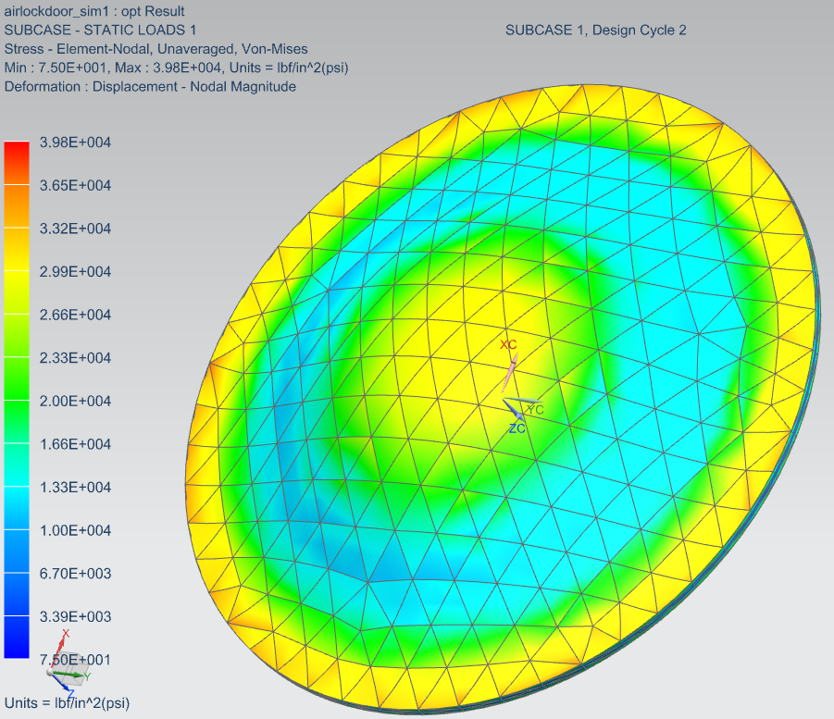
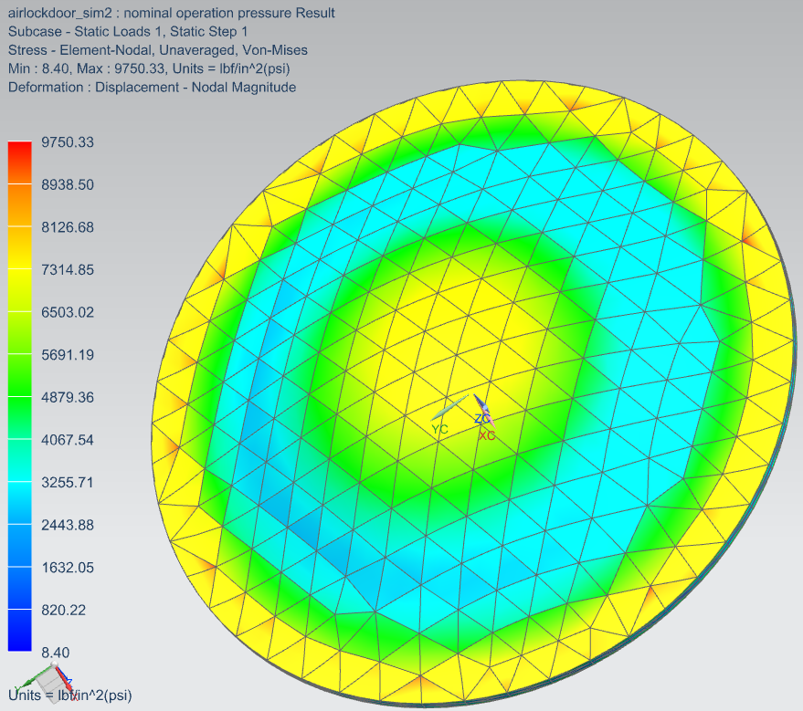
Von-Mises Stress of Bulkhead
Figure 1:
413.6 kPa
Designed load (FOS = 4)
Figure 2:
101.3 kPa
Nominal designed load case

Slide 14
Conclusion of Structural Analysis
“Classic” approach of pressure bladder/restraint layer/webbing to resist pressure forces will work for airlock up to nominal 14.7 psi pressure wiith FOS=4 and positive MOS
Airlock bulkheads and doors will be infeasible to fabrication due to (massively) insufficient funding, limited stock aluminum sizes, and limitations on available machine tools
Adopt a strategy of evolutionary development using increasingly scaled test units, with full-scale mockups for crew interface testing

Slide 15
Testing Approach
Initial focus on 1/10 scale models, moved up to 1/5 scale and then ½ scale models
Scale model approach minimizes time, cost of fabrication, supports multiple iterations
Utilize full-scale testing in neutral buoyancy to provide human factors evaluation of design
Airlock size
Hatch operation
Goal of full-scale pressure test article will not be achieved in this year’s program due to time and cost limitations

Slide 16
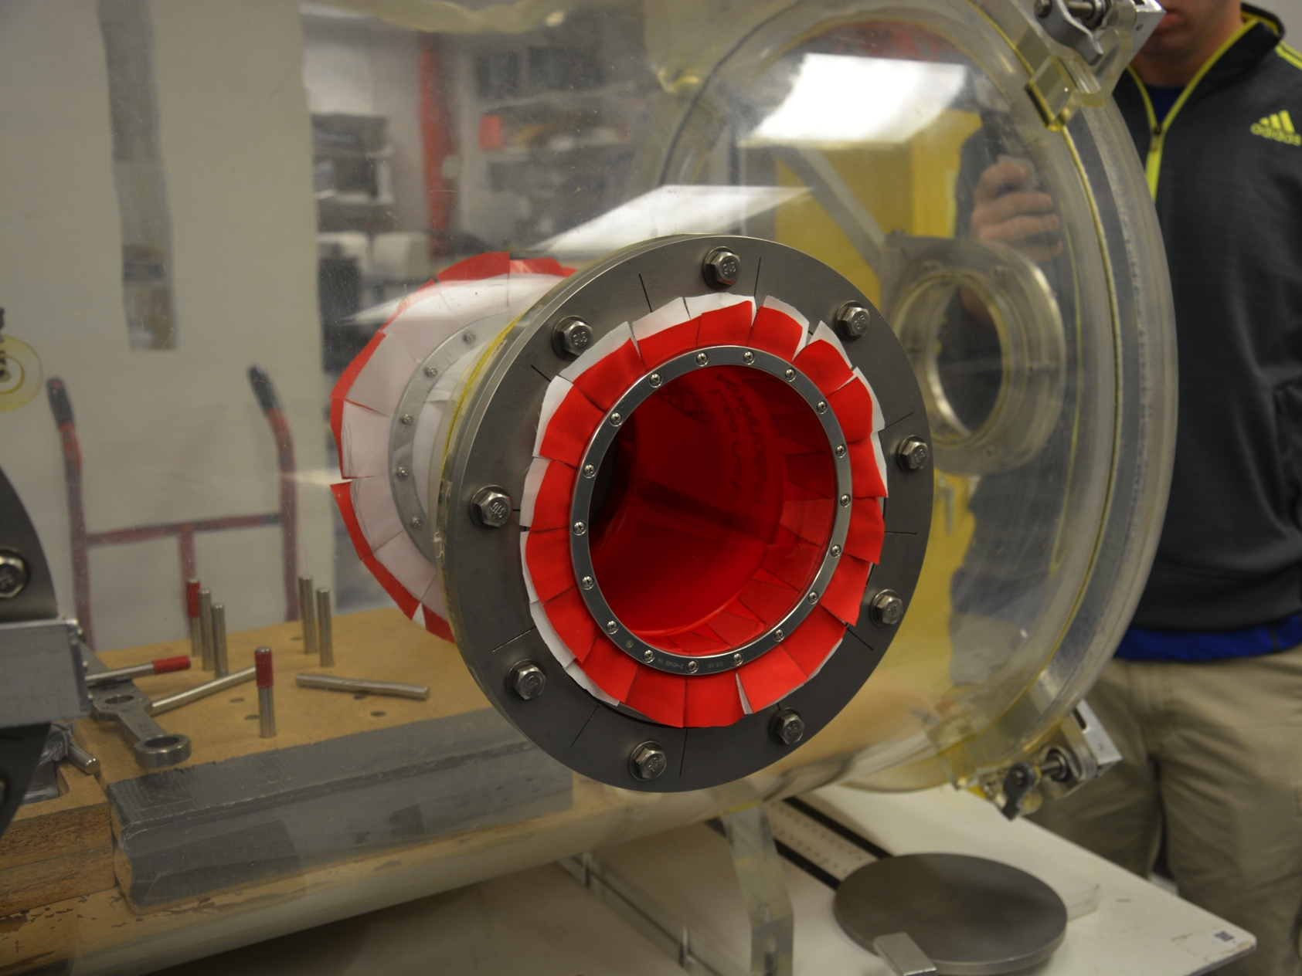
1/10 Scale Airlock Pressurized to 4.3psid

Slide 17
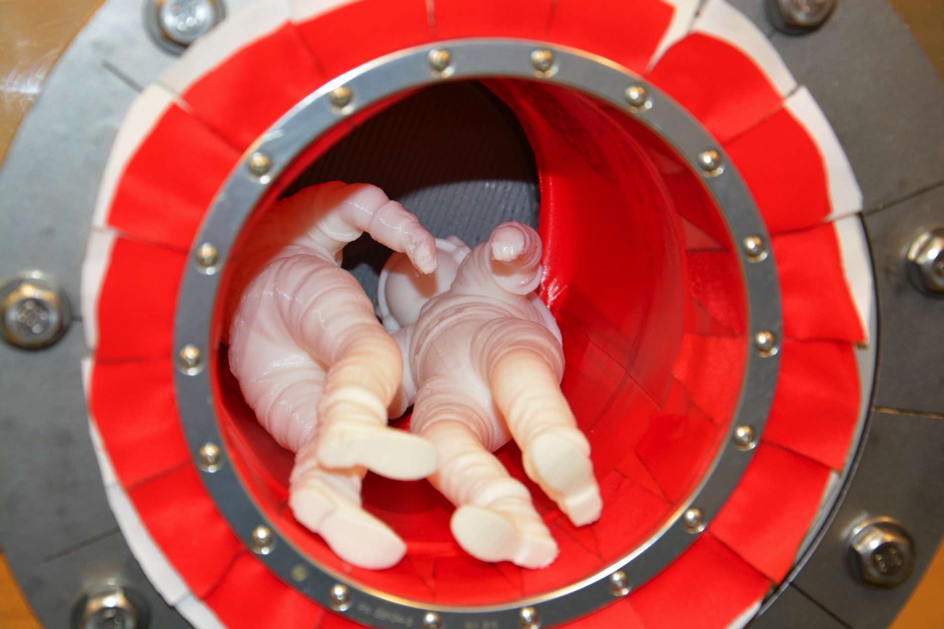
Two EMUs in Pressurized 1/10 Scale Airlock

Slide 18
Hatch Design Process
Desire to have hatch open inwards, but swing outwards
Brainstorming on hatch shapes and open/close motions
Decision to use D-shaped hatch to maximize egress area
Trades between interior and exterior “arm” mechanism to articulate and control hatch
Use of CAD and 1/10 scale modeling

Slide 19
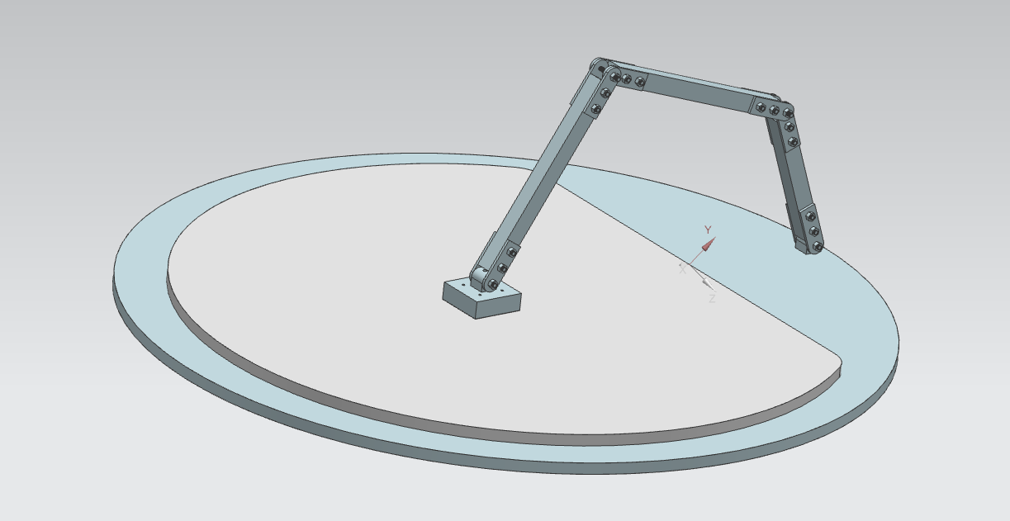
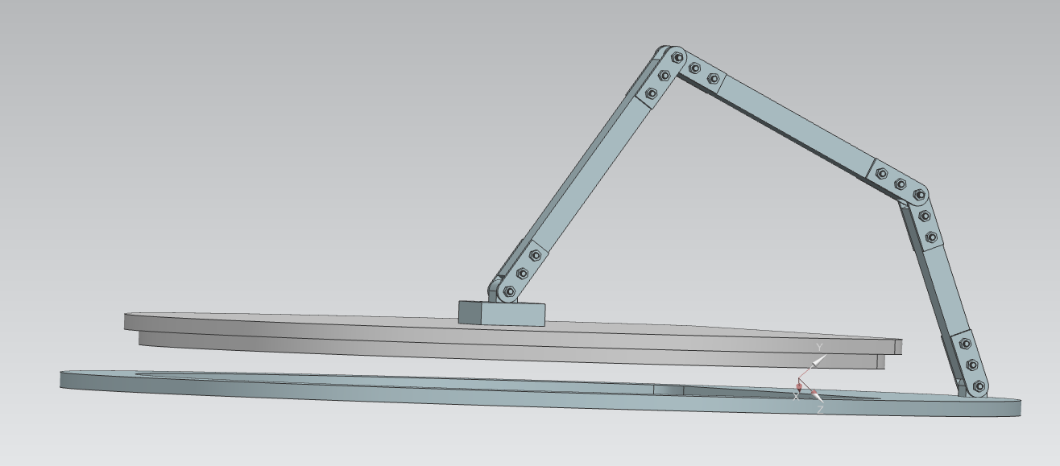
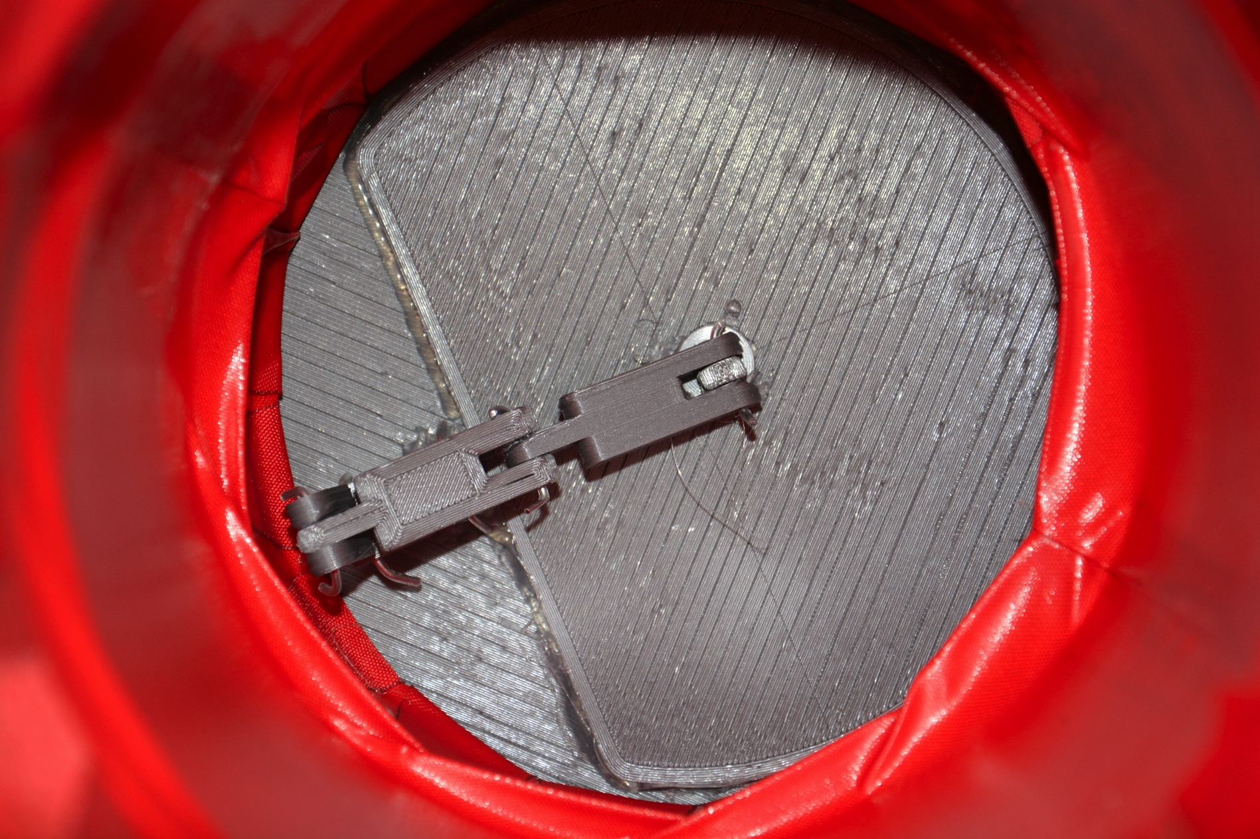
Hatch Mechanism
Five degree of freedom hatch
Located on interior of bulkhead to resist pressure

Slide 20
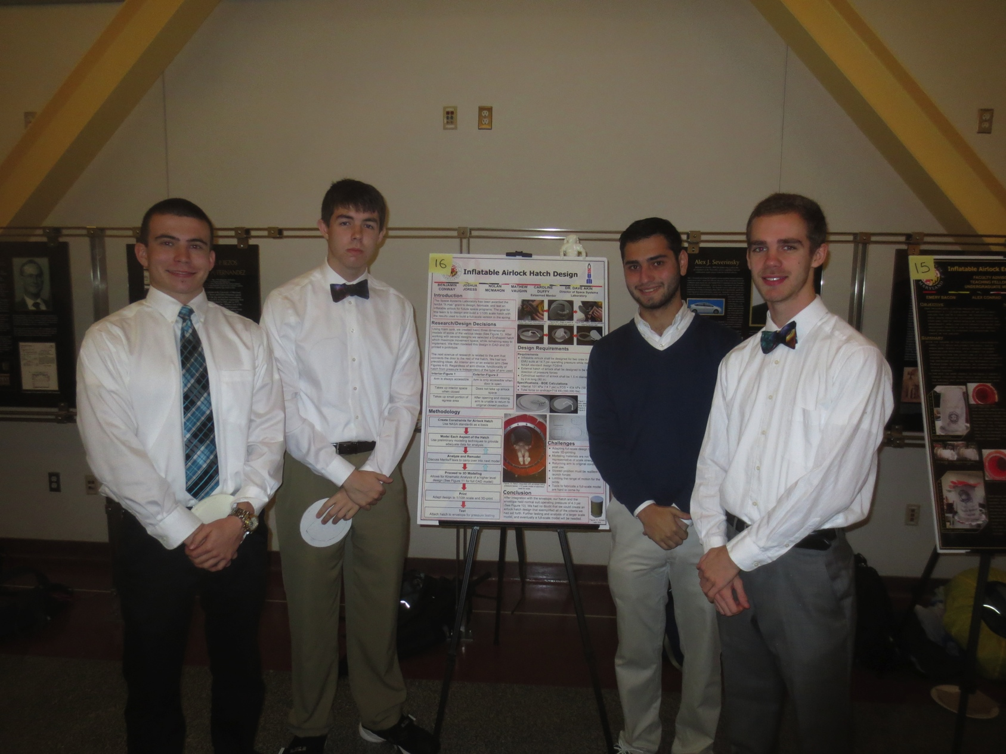
Freshman Hatch Design Team 1st Place Award

Slide 21
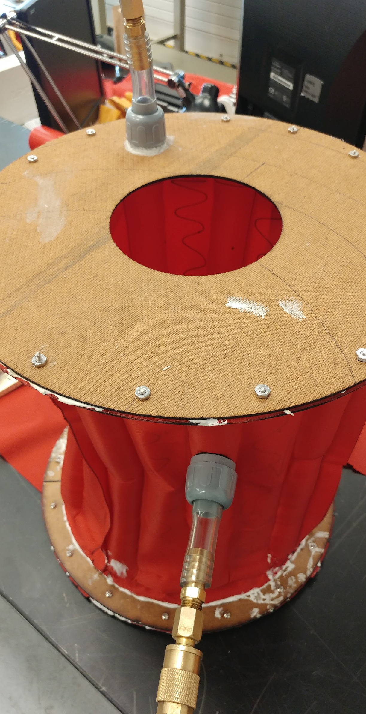
1/5th Scale Inflatable
Deemed necessary to mock up a small scale airlock to test key principles and design features
Smaller scale allowed a much quicker iteration cycle while still providing valuable insight into design features
Small scale construction also allowed for smaller and more accessible equipment to be utilized

Slide 22
Primary Goals and Requirements
Conduct scale tests to assess feasibility of:
Support bladder airlock deployment
Joint pressure envelope & support structure
Ability of basic door design to hold pressure
Test of inflation adapters (fabric to pneumatic fitting interface)
Construction of airlock using available fabric sizes
Fabric was cut to 1/5th of available size to simulate full scale material availability

Slide 23
Construction
Critical dimensions:
14” Diameter endcaps
16” Height
1” Clamping ring
Maximum material width of 11.2”
Endcaps were laser cut from masonite
Door sealing gasket was made from soft silicone rubber

Slide 24
Pressure Envelope Construction
Fabric construction was planned such that the joint pressure envelope could be constructed as one part
The inner and outer walls were created by splicing heat sealable nylon fabric to the appropriate size
Internal Support Bladder Wall
External Support Bladder Wall & Pressure Envelope
18”
39.7”

Slide 25
Pressure Envelope Construction
Support bladder was constructed as a series of interconnected bladders
Pressurized support bladders ran parallel the axis of the airlock with plenums at either end interconnecting the bladders together
This design allowed the support bladder to be inflated from one connection, reduced potential points of failure, and prevented buckling
Each end was sealed together to create a cylinder
Sealed Area
Unsealed Area

Slide 26
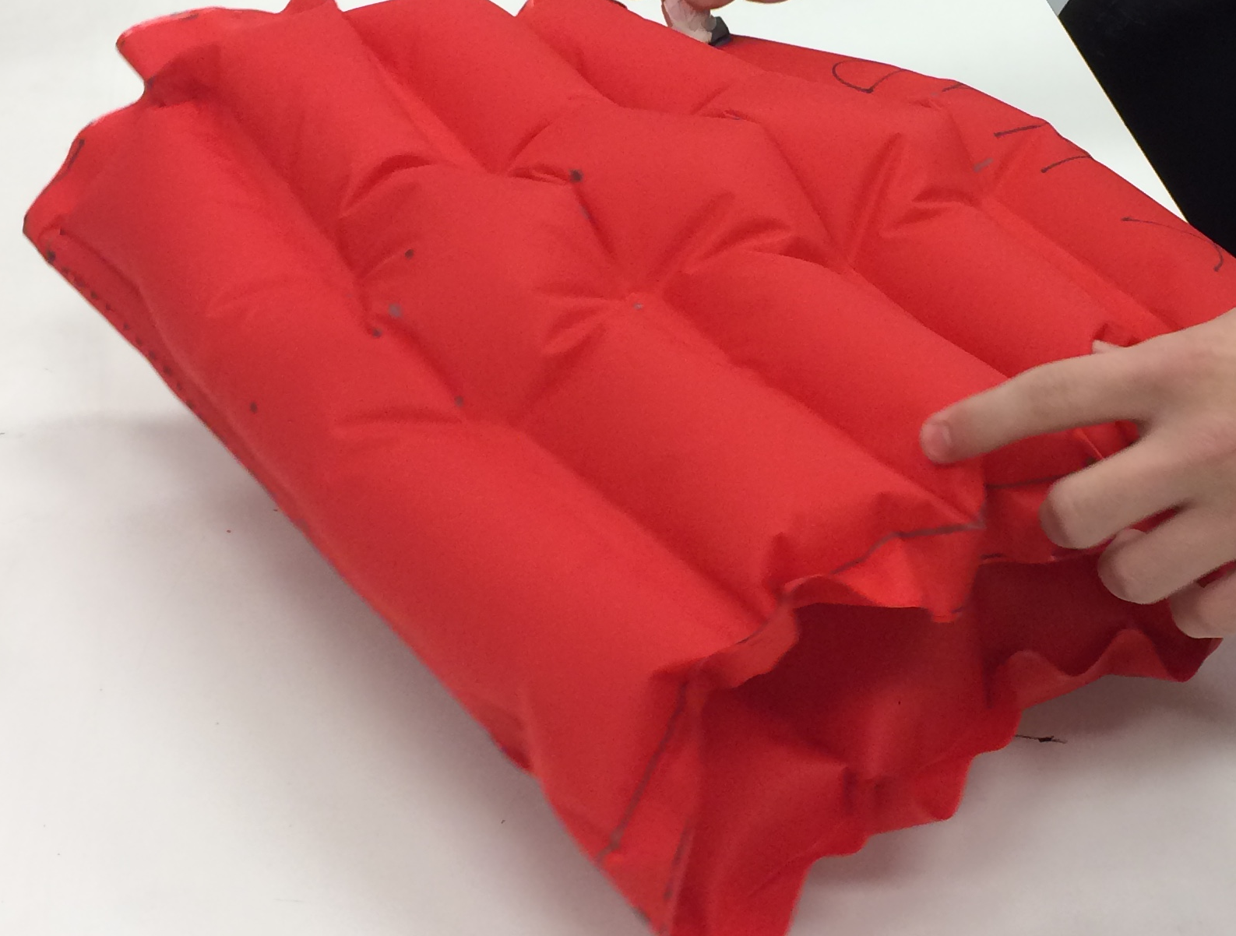
Inflatable Support Structure
Structure did not sufficiently support lateral loads
Folded upon on itself when inflating
Displayed buckling at the plenum
Developed leaks at some heat-sealed locations
Further testing with plenums at top and bottom will be conducted with improved seal

Slide 27
Final Assembly
Interior Pressure Fitting
Endcap w/ door frame
Additional rings were heat sealed to the ends of the pressure envelope to strengthen the pressure seal
Clamps and Silicone/Latex Caulk were used to seal fabric envelope to endcaps
Fittings were added to pressurize airlock
Door Insert
Pressure Envelope & Clamps
Support Bladder Pressure Fitting
Solid Endcap

Slide 28
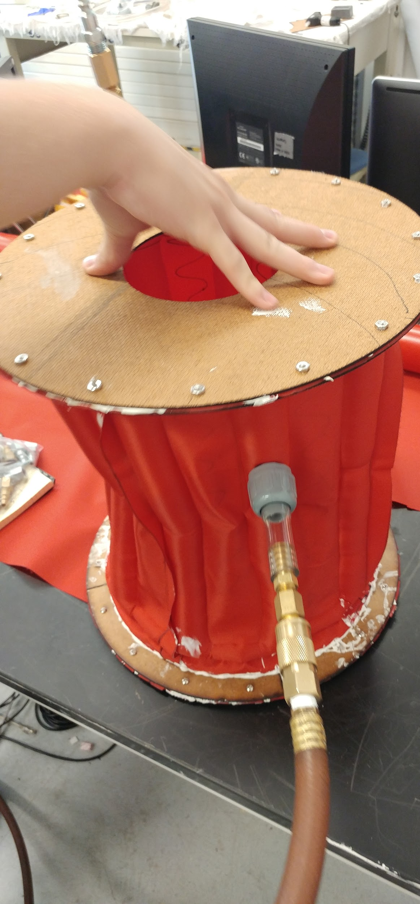
Results
Using smaller composite fabric pieces, an airlock that was able to hold pressure was successfully constructed
Support bladder was able to facilitate airlock deployment
Support Bladder was able to hold small scale endcap and 20 lbs. extra weight
Door gasket was able to hold pressure, but the masonite endcaps bowed out resulting in leaks along the door edge
Pneumatic interface adapters were more than adequate for holding pressure despite minor leaks

Slide 29
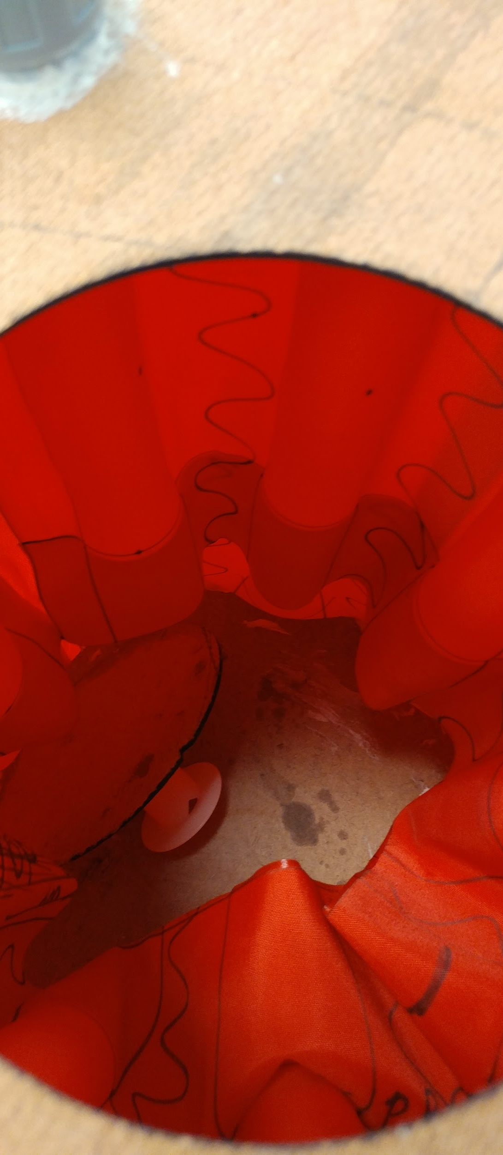
Results
There was an observable internal volume loss due to the support bladders bowing inwards.
Further testing was done to determine the extent of the issue at ½ scale.
Inflating from one point caused asymmetric pressurization and inflation
Joint pressure envelope & support structure were able to operate in conjunction, but complications with the endcaps made a simultaneous support bladder/pressure envelope test impossible
Overall, scale model provided promising results for current airlock design methodology

Slide 30
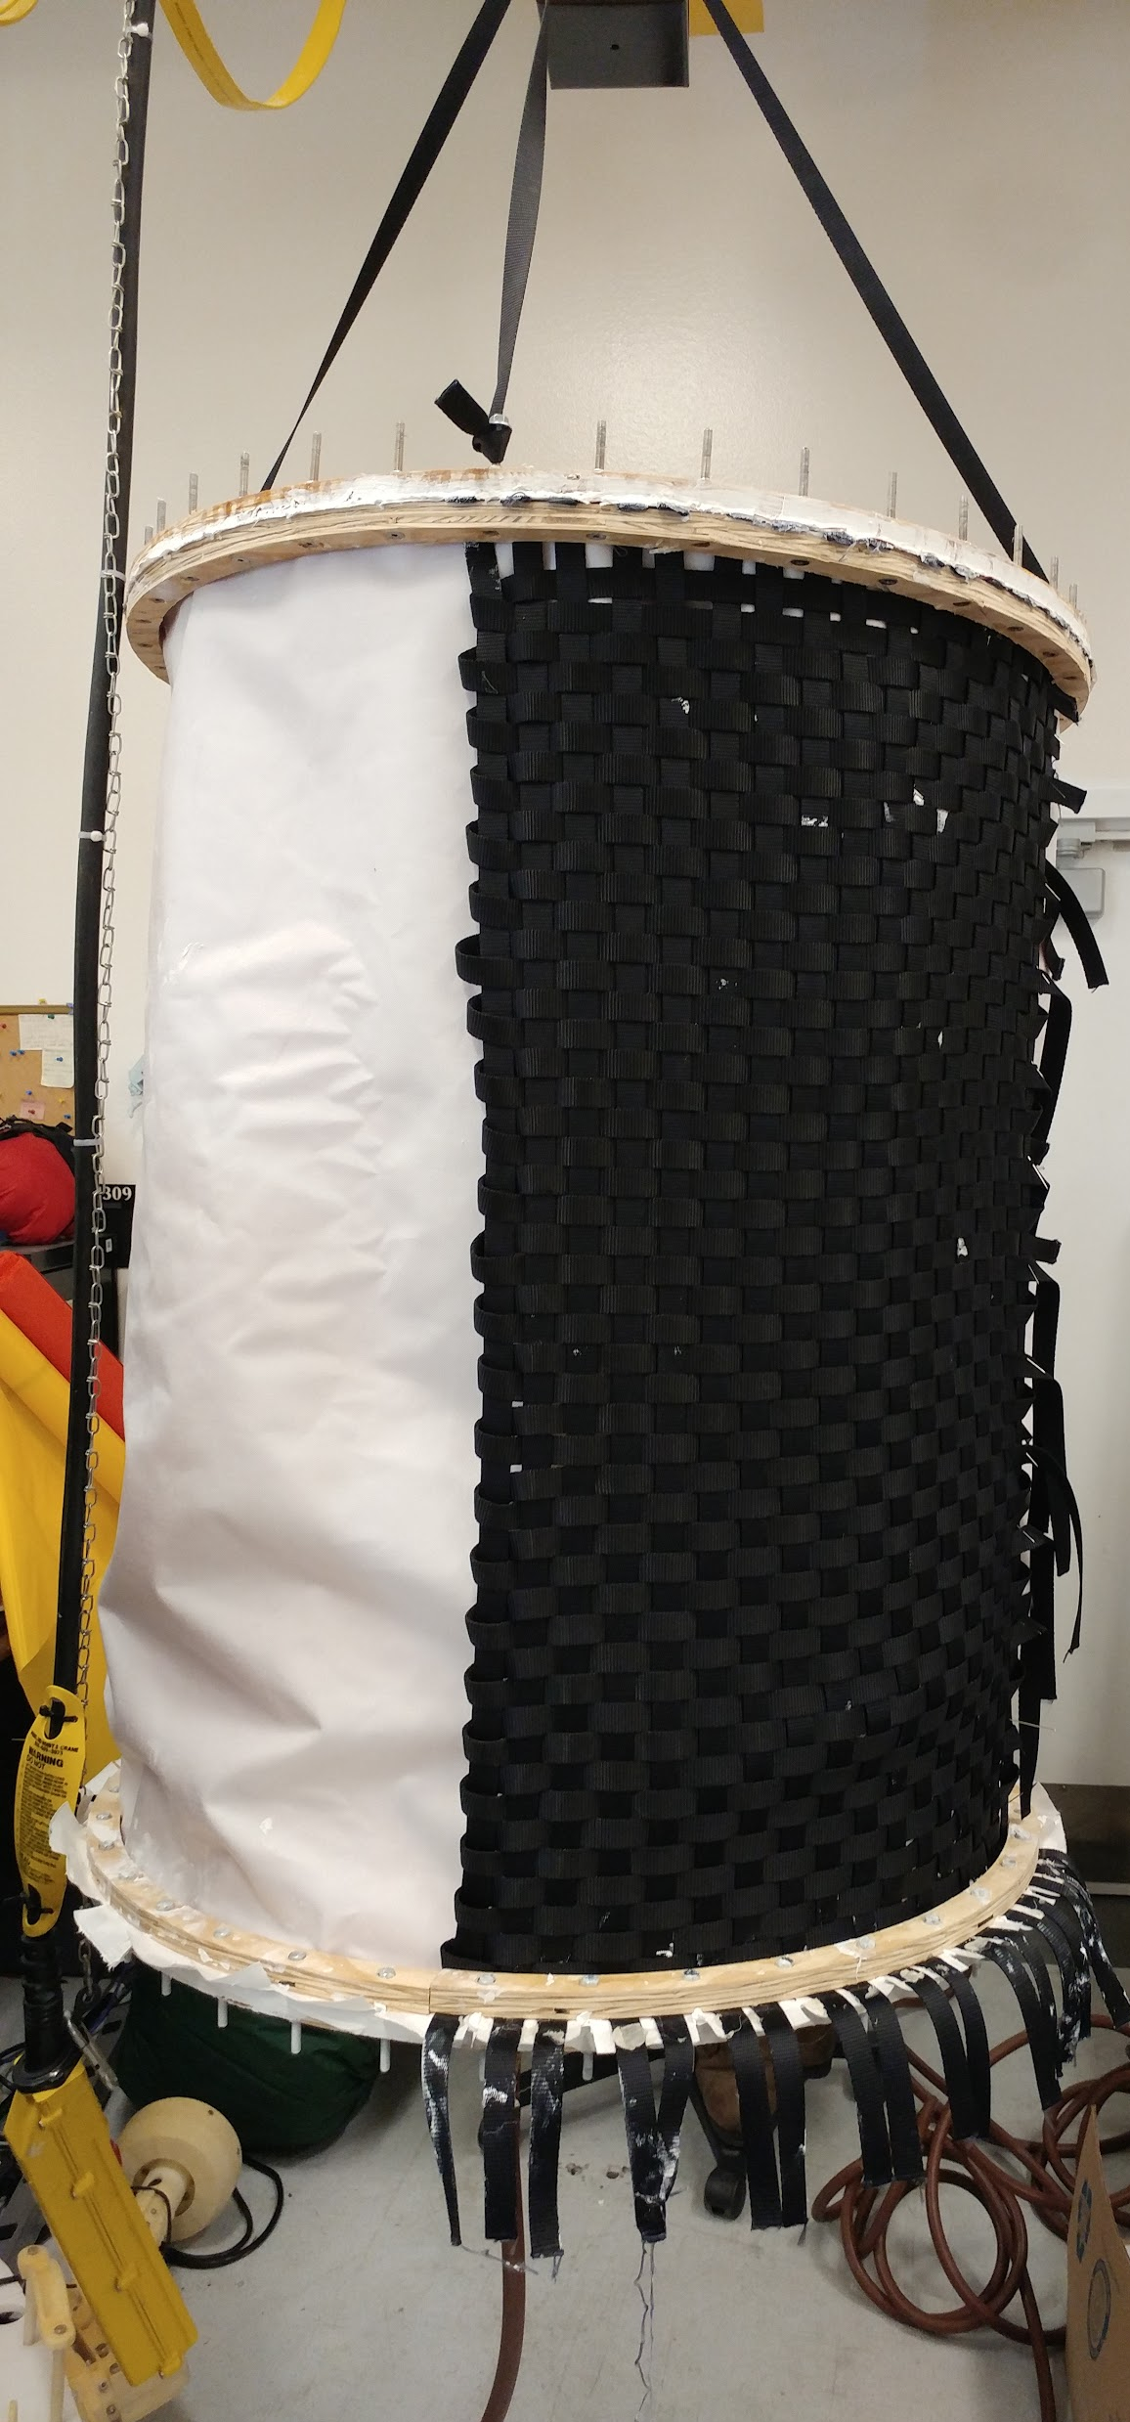
1/2 Scale Inflatable
After observing the problems with a 1/5th scale airlock, it was deemed necessary to construct another scale mockup to observe how these problems scale with the size of the airlock.
An additional scale mockup also allowed us to ignore features that proved sound in 1/5th scale, while focusing on the problems encountered (or not yet addressed) at a smaller scale.

Slide 31
Primary Goals and Requirements
Conduct scale tests of:
Support bladder airlock deployment with larger scale endcap
Joint pressure envelope & support structure pressurization
Scaling of volume loss given similar support bladder construction, but with a larger airlock
Internal pressurization under ideal conditions (No door)
Deployment and Stowage configurations with outer lining and nylon webbing restraint layer

Slide 32
Construction
Critical dimensions:
32” Diameter endcaps
40” Height
1” Clamping ring
Endcaps were CNC Milled from ¾” Plywood
Pressure Envelope was made from heat sealable Nylon
Outer lining was made from white nylon fabric
Webbing restraint layer made from ¾” nylon straps

Slide 33
Pressure Envelope Construction
Fabric construction method was nearly identical to that used for the 1/5th scale mockup
The size of the axially oriented pressure bladders were kept constant to observe scaling of internal volume loss
96.25”
Pressure Envelope
42”

Slide 34
Outer Layer Construction
Additional outer layers were added to better simulate packing necessities for stowage
An outer nylon restraint layer was created, and a quarter of the outer envelope was covered with a ¾” nylon webbing weave
These layers were secured to the endcaps using the same clamps as were used for the pressure envelope.

Slide 35
Results
Support bladder was not able to fully support endcap under 1G, but was able to when the weight of the supported endcap was neutralized (~µG)
A lead counterweight (15 lbs) was used to offset endcap weight
When both the pressure envelope & support structure were pressurized, the airlock was able to support the weight of the airlock and tension the nylon webbing restraints

Slide 36
Results
The volume losses caused by support bladder inflation were larger than those at ⅕ scale, and there was additional bowing of the axial support bladders
This was partially resolved through simultaneous inflation of the internal pressure envelope
Using the bulkhead clamp/caulk seal, the pressure envelope was able to hold 10 psi (Not tested to failure)
At larger scale, the heat seals, particularly on the support bladder, were showing greater signs of weakness under pressure

Slide 37
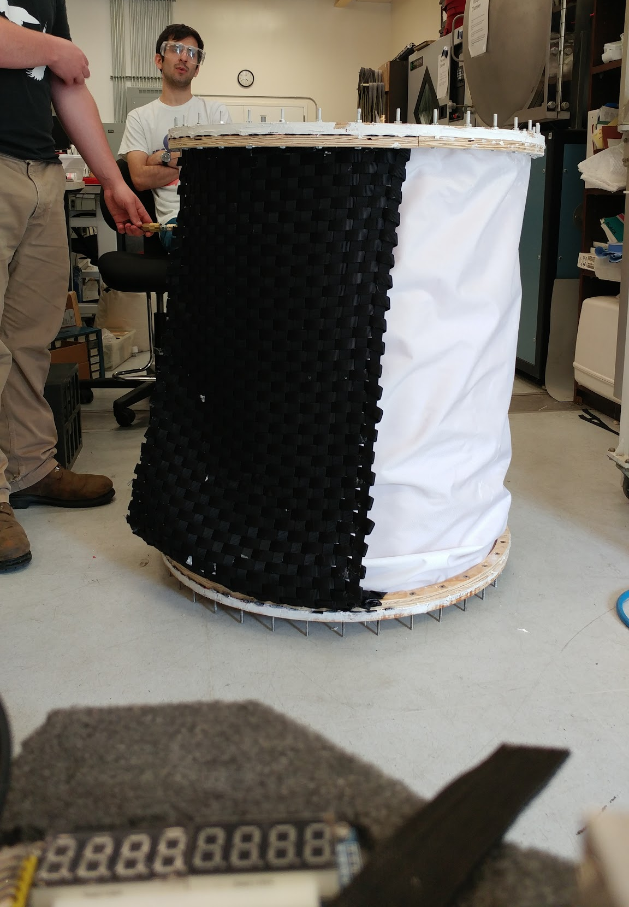
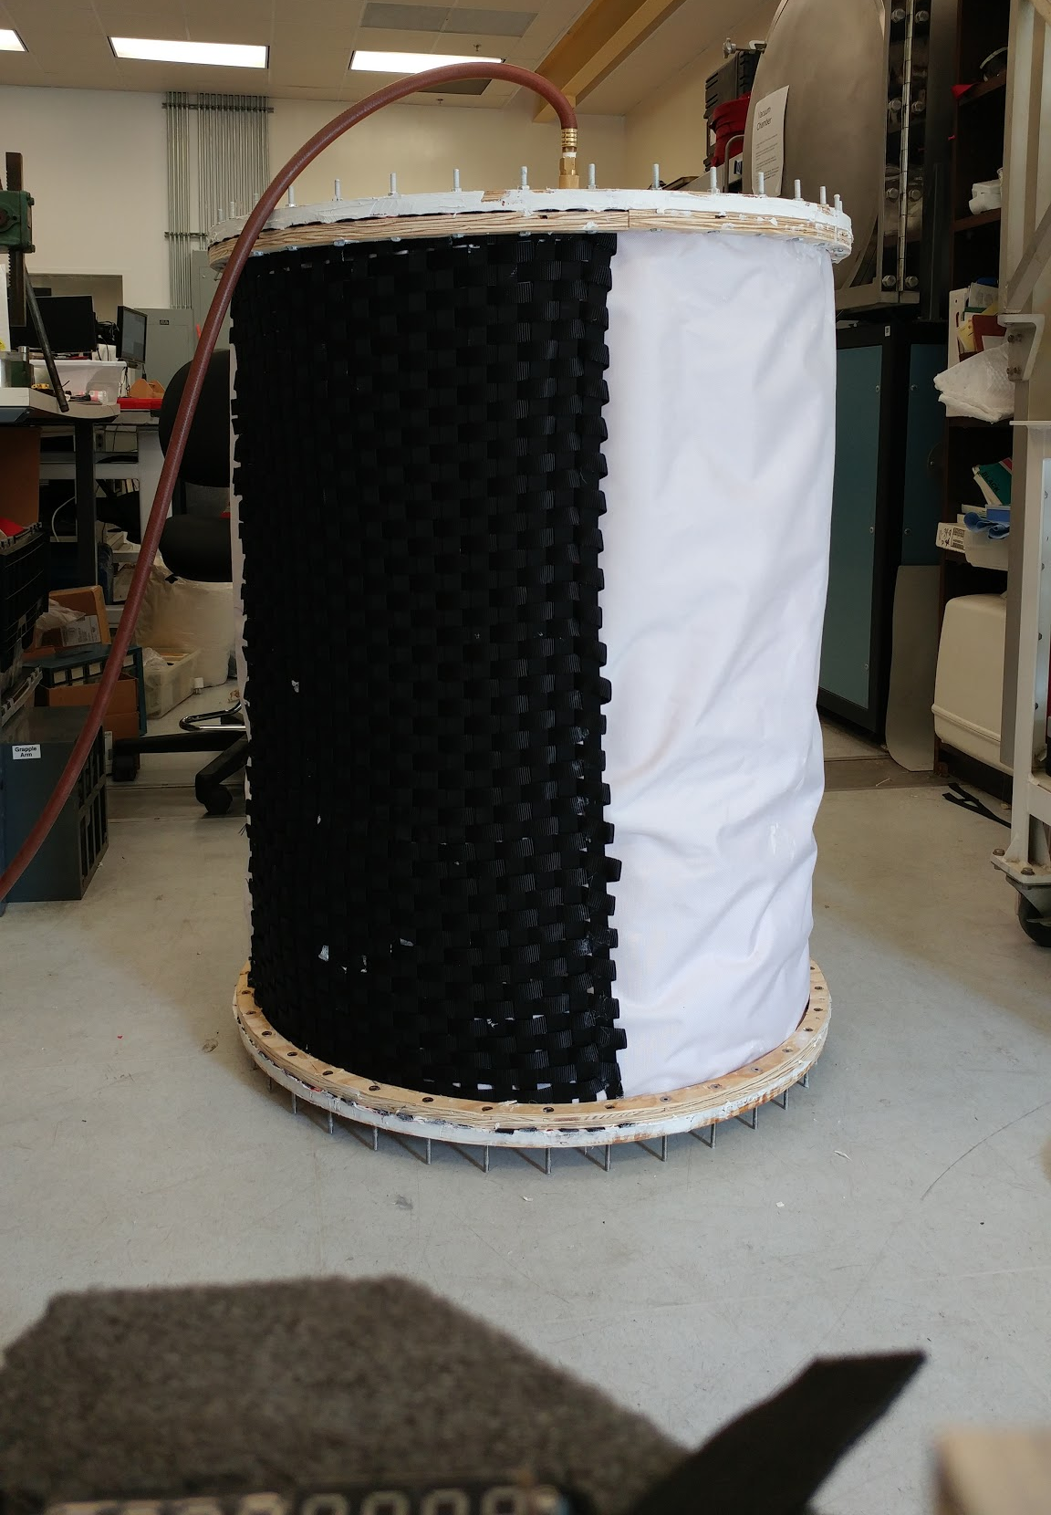
Support Bladder Inflated Only
Support Bladder & Internal Pressure Bladder Inflated

Slide 38
Stowage Configurations
Airlock was able to inflate from a wide range of configurations
Anticipated to become harder as more layers are added
To minimize potential obstructions in the support bladder, the bladder and restraint layer were folded into an accordion shape.
After observing the behavior of the sample nylon webbing, it was decided that a collapsible tile configuration would allow for the more efficient and less crowded storage.
This configuration allows for the nylon webbing restraint layer to be folded and stowed outside of the circumference of the endcap.

Slide 39
Alternative Bladder Design Methodology
After testing at ½ scale, it became apparent that the pressurized support bladders would have to be strengthened and reconfigured in order to satisfy baseline design requirements (Internal volume, strength)
This design would have to be compatible with single sided heat seal fabric
The critical points for reinforcement were the sealing interfaces, where the stress concentrations were the highest

Slide 40
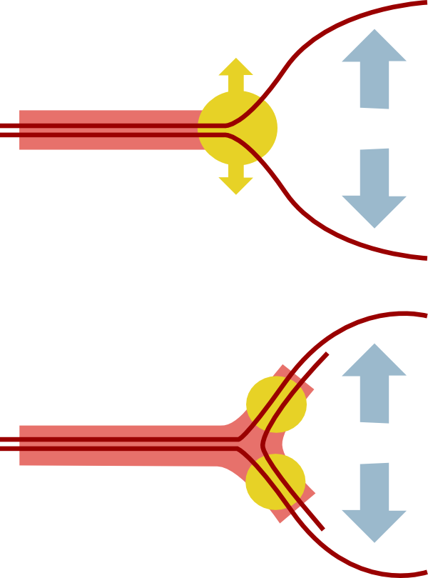
Alternative Bladder Design
A reinforcement segment was added to further join the upper and lower nylon layers
Internal pressure places this segment under tension, instead of working to peel apart the sealed layers
A single bladder was constructed and tested against a control bladder of similar size.

Slide 41
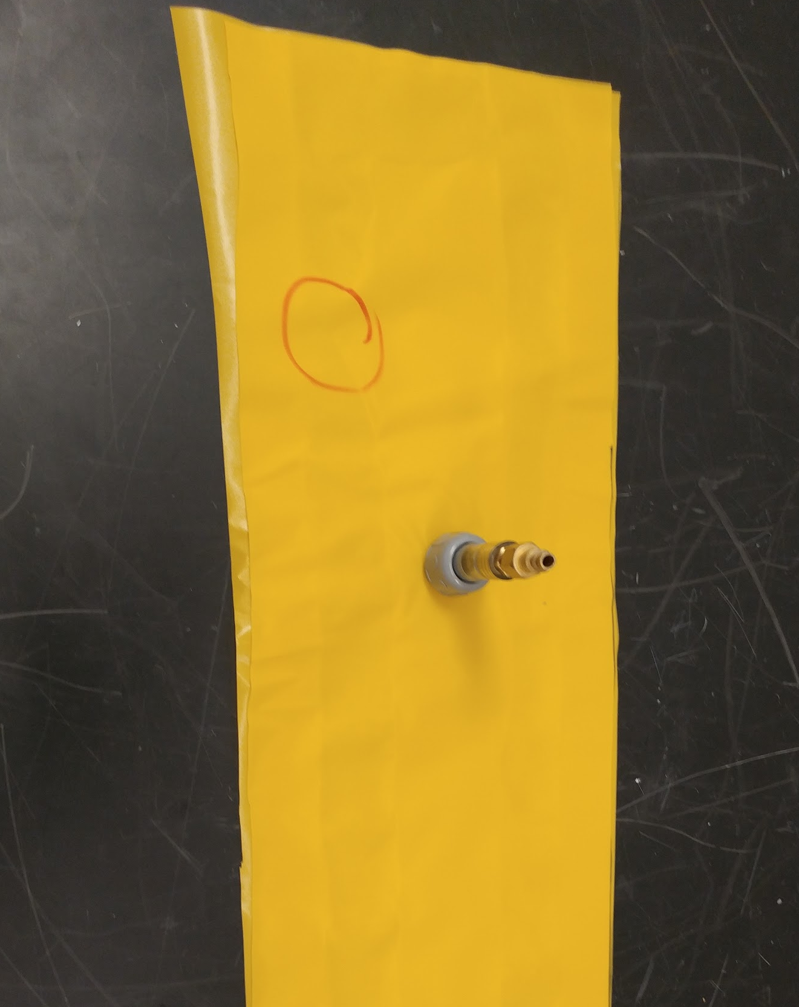
Alternative Bladder Design Conclusions
Alternative bladder design provided significant strength increase over original design
New design failed at 35 psi,
Old design failed at ~10 psi
Further reinforcement at fitting interface point required to increase tolerable pressure load
The failure in the experimental design occurred at the stress concentration where the pressure fitting was installed, not at a sealed interface.
Failure of Original Design
Failure of Experimental Design

Slide 42
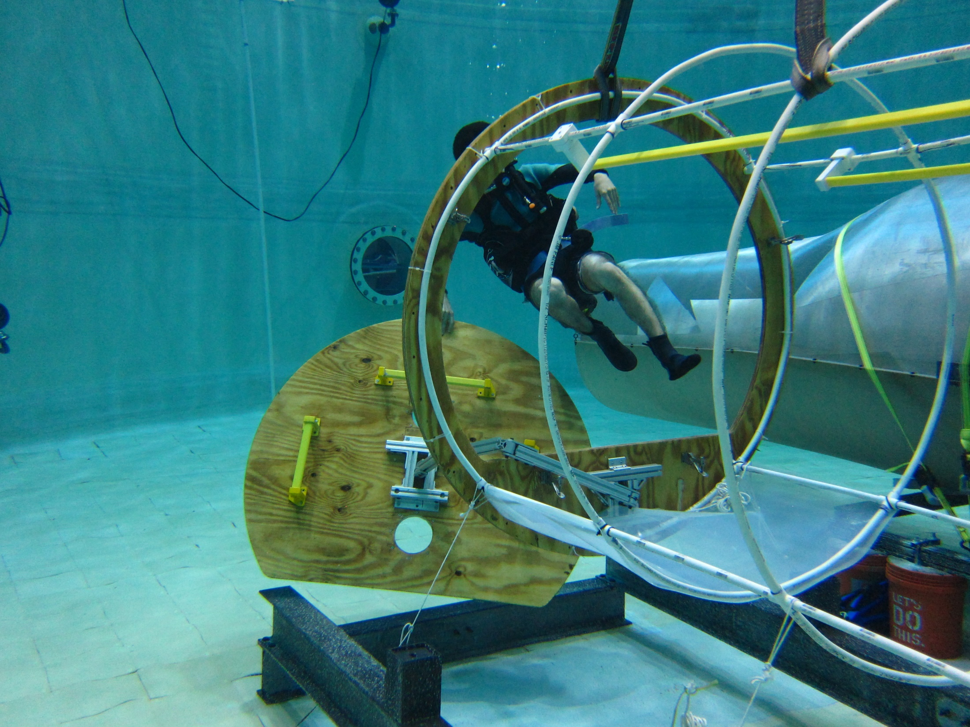
Full Scale Underwater Testing

Slide 43
Human Factors Assessment of Sizing
Location: Neutral Buoyancy Research Facility in the Space Systems Laboratory at UMD
Tested different diameters using SCUBA divers
Airlock mock-up consists of pliable plastic to represent airlock cylinder portion
System of zip-ties and edge ribbing to keep the cylindrical shape
Ratchet belts to change diameter size
PVC pipes to attach mock-up to floor structure
Mockup diameter can be changed underwater

Slide 44
Design Objectives
Conduct airlock sizing tests
Fabricate full scale hatch and bulkhead
Design and build hatch arm
Create rigid airlock size simulator
Conduct water tests of full scale airlock

Slide 45
Airlock Sizing Testing Procedure
One- and two-person configurations
Three diameter sizes:
60 in. (1.524 m)
54 in. (1.3716 m)
48 in. (1.2192 m)
Head-first and feet-first movement within airlock
180 degree turn while inside airlock
Multiple two-person configurations of relative position and orientation

Slide 46
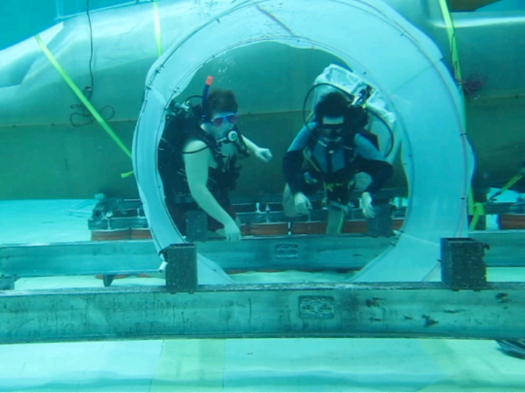
Airlock Sizing Test Set-Up

Slide 47
Sizing Tests
Sizing airlock mock-up consists of pliable plastic to represent envelope with variable diameters
System of zip-ties and edge ribbing to keep the cylindrical shape
Ratchet belts to change diameter size
PVC pipes to attach mock-up to floor structure
Mockup diameter can be changed underwater
Assessed each diameter using SCUBA divers as representative astronauts
Tests showed 60 inch diameter as favored.

Slide 48
Airlock Sizing Results
60 in. is the minimum diameter for performing all configurations tested
Two people will often pack together in an optimal configuration, which requires some sort of planning ahead of moving through the mock-up
Divers report that best configuration is back-to-back
Full extension of arms/legs will be limited by the size of the astronaut
54 in. and 48 in. diameters severely limit movement of two divers inside the mock-up at once

Slide 49
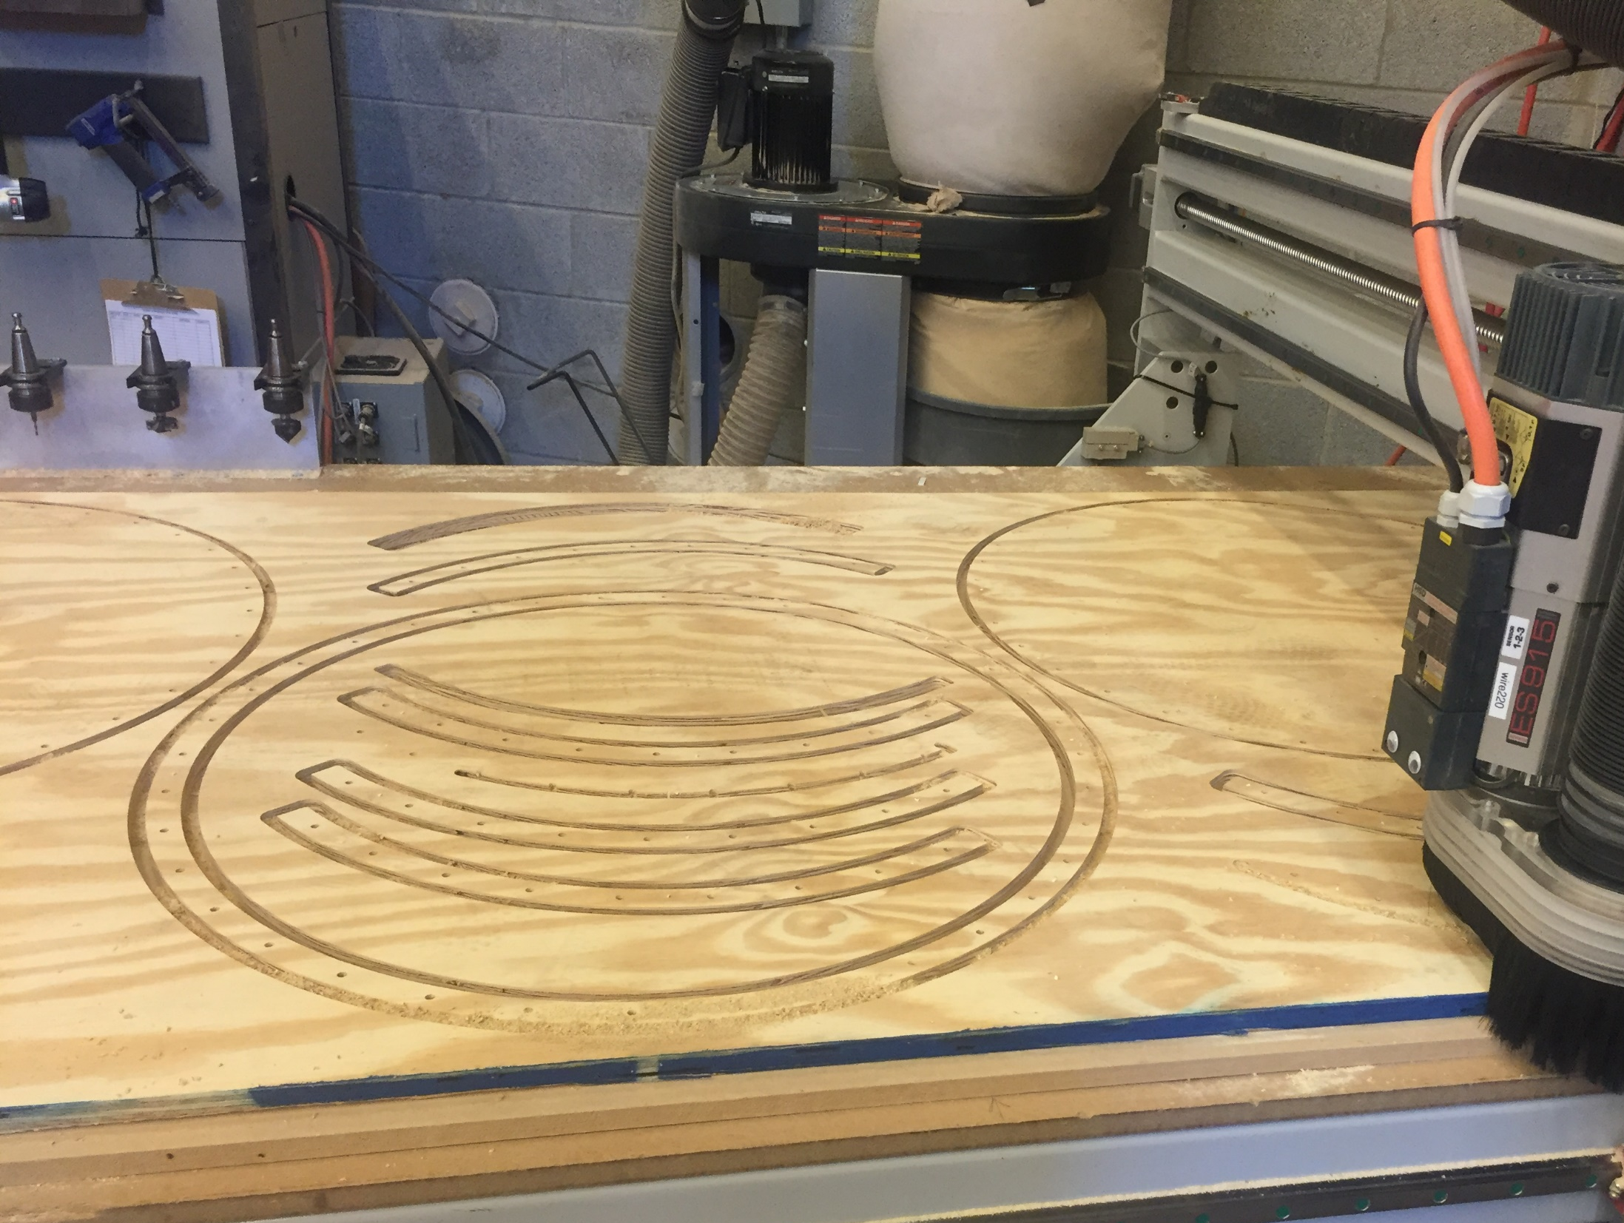
Full Scale Hatch Fabrication
Hatch was constructed on a CNC router out of half inch plywood
Coated in West-System Epoxy

Slide 50
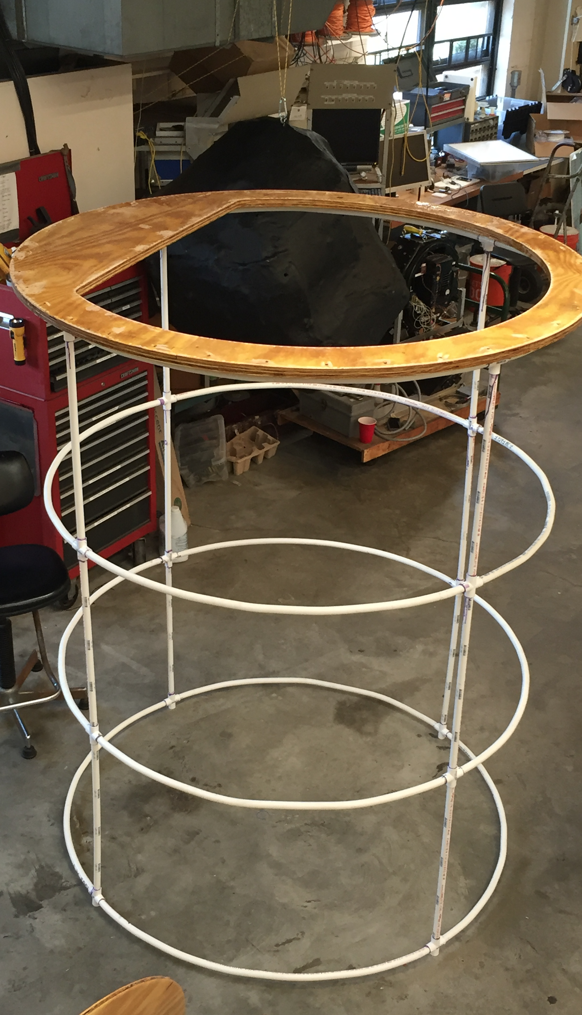
Hatch Testing Rig
To perform hatch testing, needed a structure to mount hatch on
Fabricated from PVC pipes, heat bent into 90 degree sections to form envelope
Full-scale mockup:
60” diameter
80” height
Zip-tied bulkhead to top of structure
For diver safety, structure remains uncovered frame

Slide 51
Mounting Configuration
First water test with hatch mounted to PVC frame
Goals: find secure way of mounting test setup underwater + Actuate hatch without arm mechanism attached
Results: Ruled out vertical mounting position
Able to actuate hatch, but motion was difficult in the position.
Found buoyancy issues with hatch that needed to be addressed

Slide 52
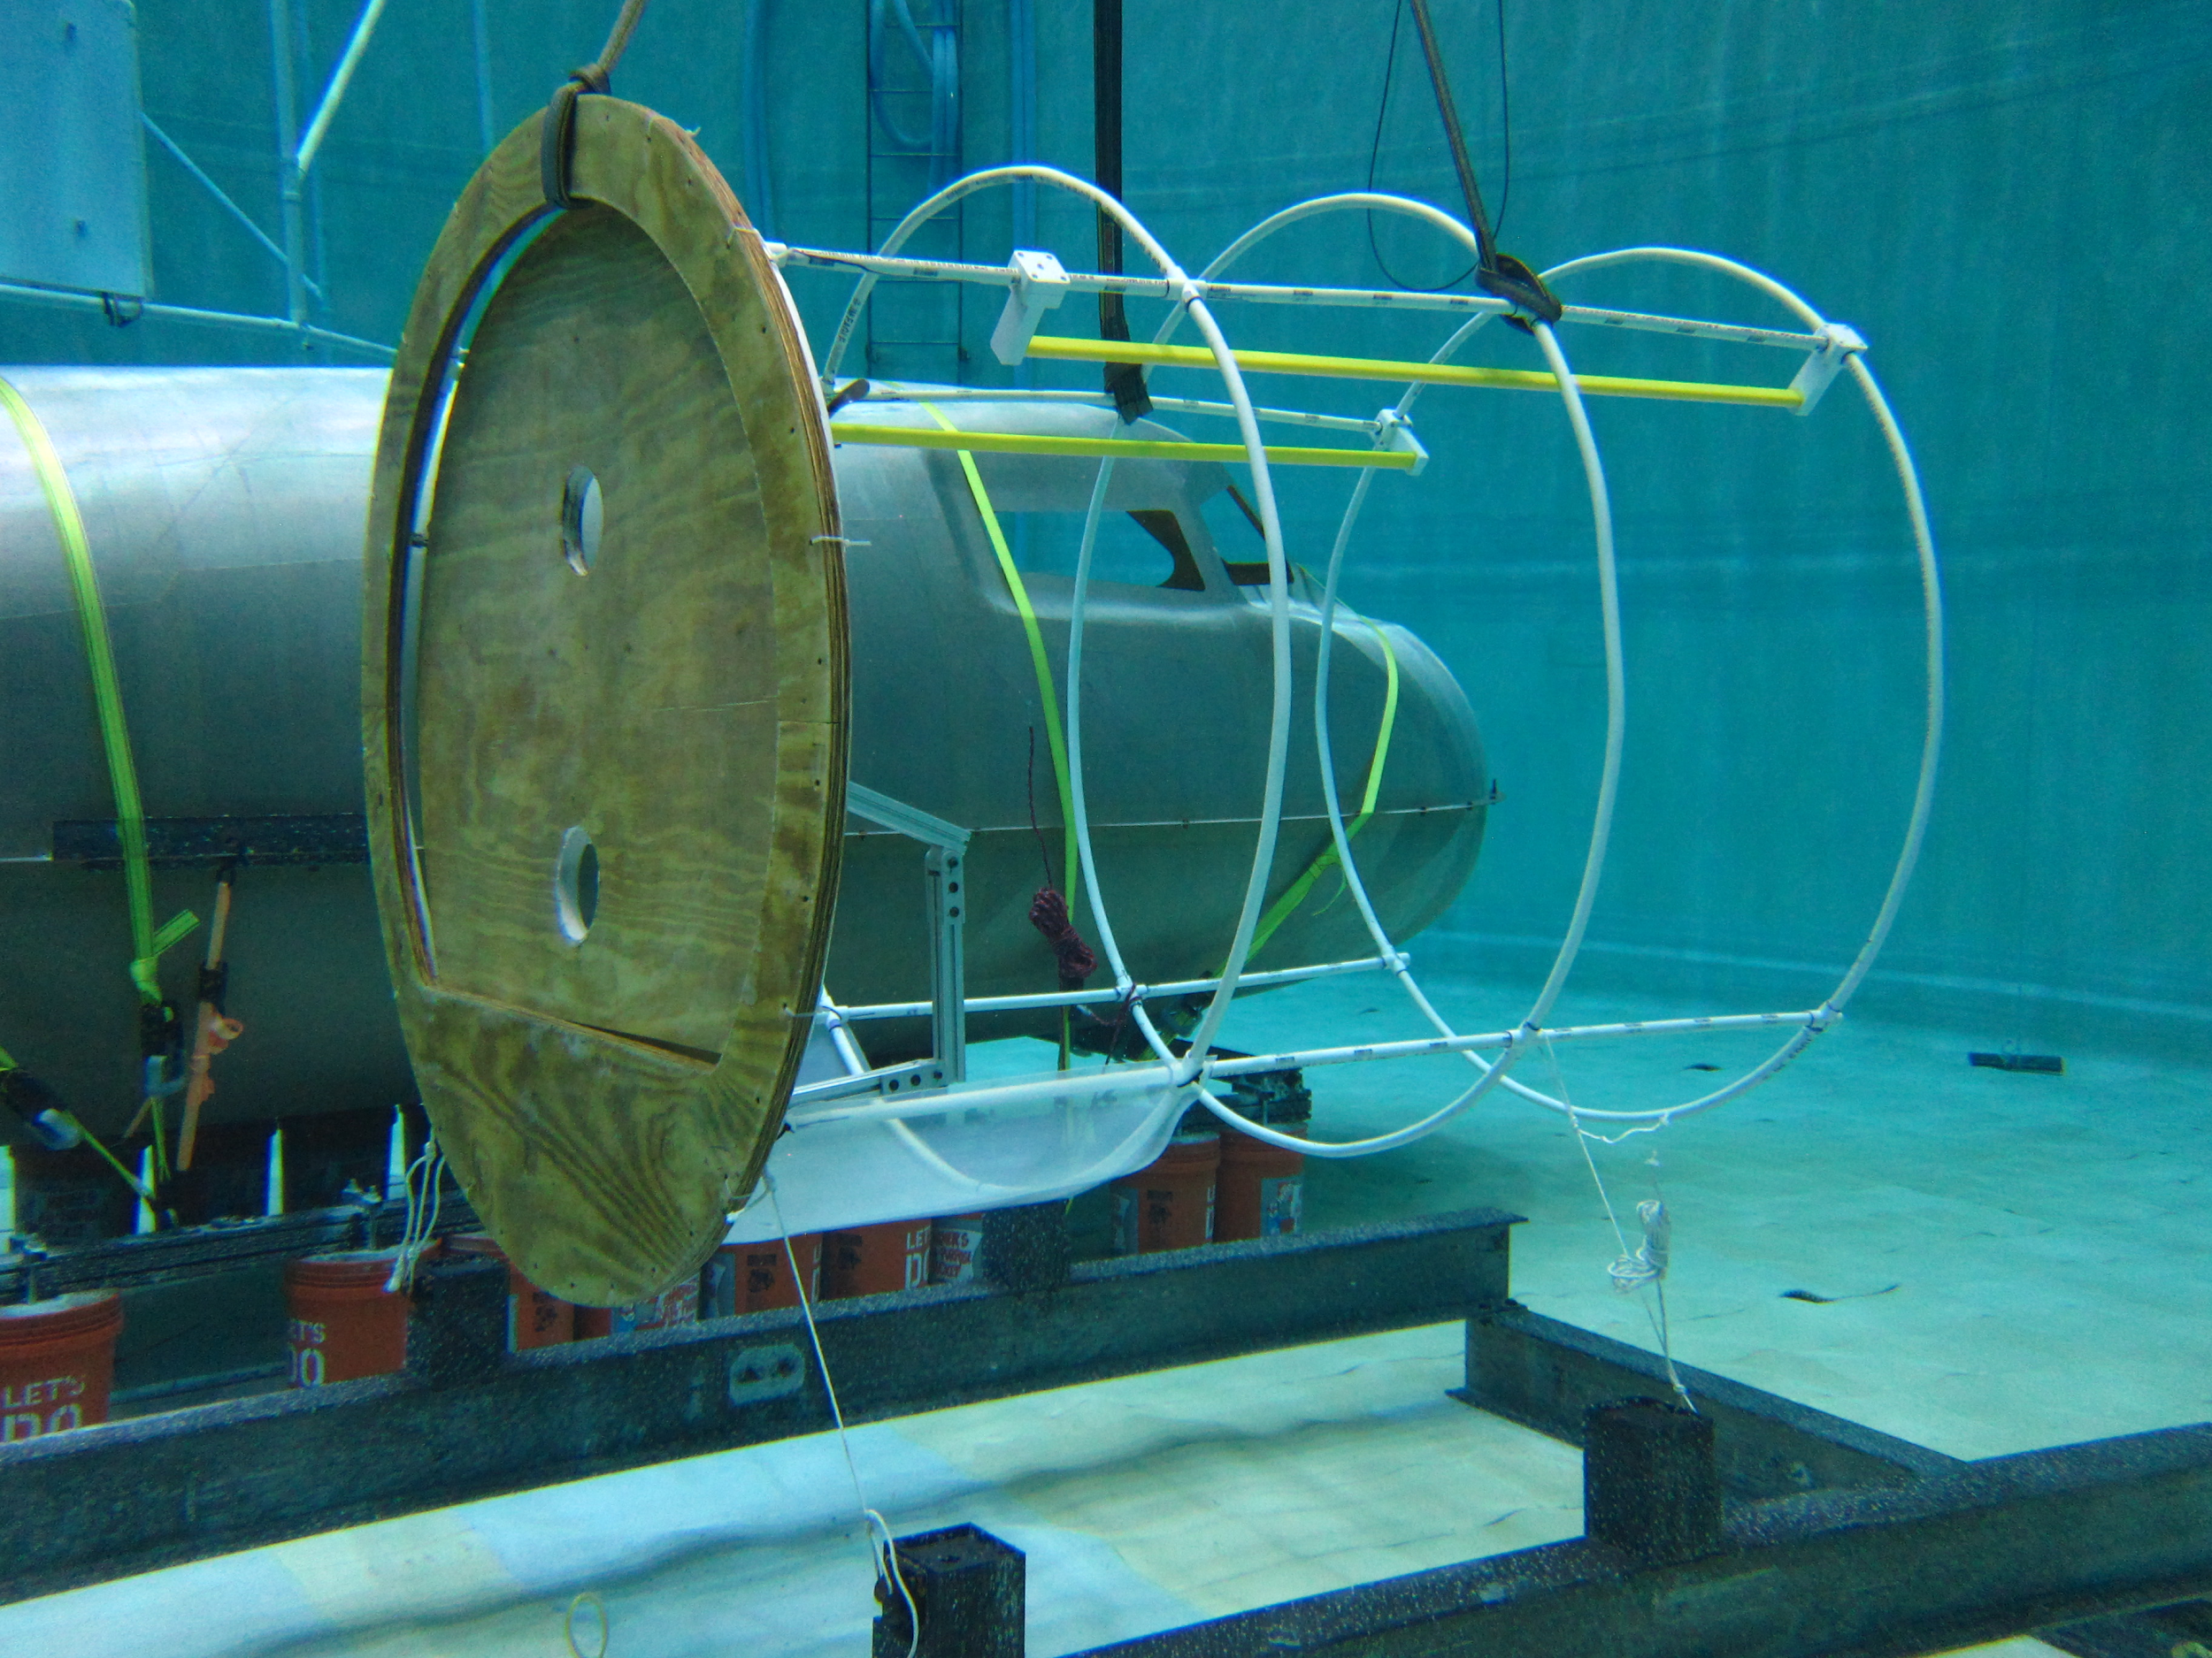
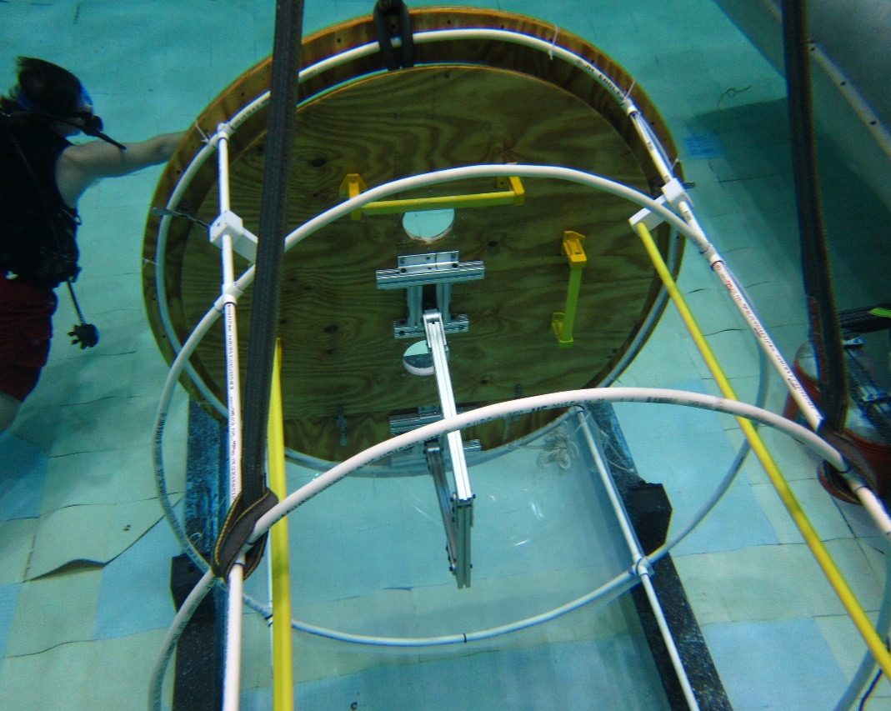
Mounting Configuration
Second test configuration with hatch bulkhead, first time with arm attachment and handrails
Attempted horizontal mounting configuration
Tied PVC structure to RANGER platform and used crane to create tension
Setup was stable and allowed for hatch testing to proceed

Slide 53
Arm Design
The arm was anchored at the center of mass which was found to be 3in off from the foci of the arc
For structural integrity 80/20 was used since it could withstand the 60lbm point load of the door for out of water testing
The three segment design was intended to limit the impedance into the habitable volume
A more advanced arm would include only two segments and have a prismatic joint in each segment to maintain functionality while being easily stowed

Slide 54
Hatch Testing Results
Basic airlock hatch concept is feasible for microgravity operation and provides some operational advantages (i.e., held closed by pressure but opens outwards)
PVC framework is adequate for initial testing, but does not prevent inadvertent violation of envelope
Handrails are critical – circumferential handrails on the inside and outside of hatch bulkhead would be ideal
Foot restraints would be highly desirable for hatch manipulation, but attachment and adjustment will be critical
Hatch articulation arm should be designed to provide detents and latches in critical configurations
Additional kinematic studies should be performed to refine arm design
Future testing should incorporate suit simulators and realistic backpacks

Slide 55
Recommendations for Further Development
Need a better approach to bulkhead and hatch fabrication than wood with epoxy sealant
New concepts in inflatable wall design should be prototyped and assessed
Full-scale inflatable airlock prototype would allow assessment of functionality of inflatable wall for depressurized rigidization
Airlock hatch may need to be reduced in size to allow sufficient room for latches and handrails
Better arm kinematics will reduce the force and reach required to open and close hatch
Increased fidelity in both airlock and spacesuit components
Protoflight system with full hydrostatic qualification

Slide 56
Conclusions
Basic functionality of an inflatable airlock concept have been verified
Inflatable envelope
Rigidization of walls during depressurized operations
Innovative hatch design
Efficacy of crew interfaces were demonstrated in neutral buoyancy
Project involved students from freshmen through grad students
Resulted in Aerospace Engineering design award, and was incorporated into senior capstone design for Phobos Outpost
Paper on results to be presented at AIAA Space 2016 conference in September

